Slide 1
Attention, Transformers, BERT, and Other Modern Sequence Processing

Slide 2
Review – Sequence Problems

Slide 3
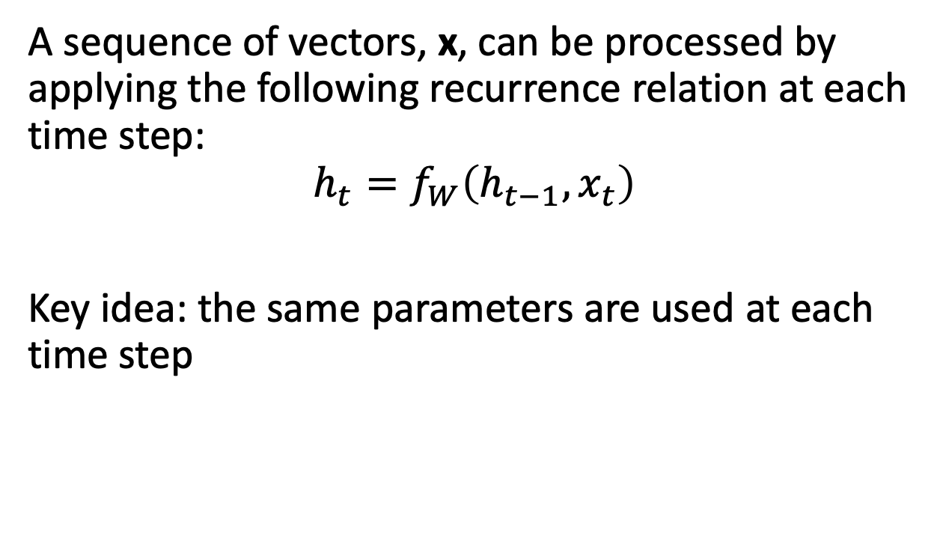
Recurrent Neural Networks
A sequence of vectors, x, can be processed by applying the following recurrence relation at each time step:
$$h_{t}=f_{W}\left(h_{t−1}, x_{t}\right)$$
Key idea: the same parameters are used at each time step

Slide 4
Problem
Recurrent neural networks are difficult to train on long sequences
Machine Translation – difficult to summarize an entire sentence in one feature vector
Today we will introduce “Attention”, a mechanism to improve long-term relationships in sequences

Slide 5
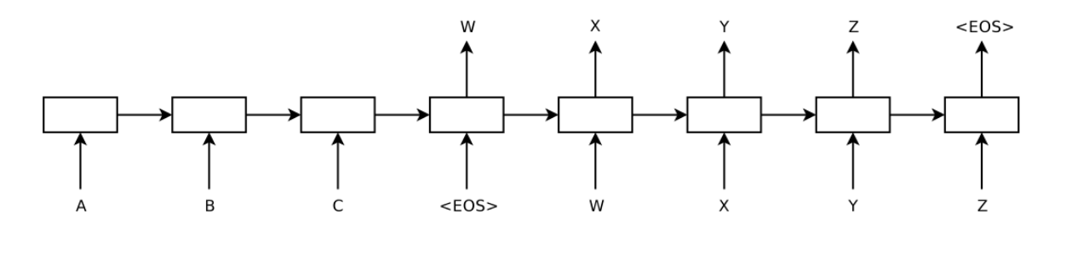
Review – Sequence to Sequence Translation
Encoder/Decoder model used for machine translation:
Network reads a sentence and stores the information in the hidden units

Slide 6
Attention
Define relationship between points in the input and output sequence
During encoding, each word is represented as a vector
Similar to hidden state in previous RNN models
During decoding, input to hidden state is linear combination of input states
Corresponding to a weighted average of the important of each input state for that particular output state

Slide 7
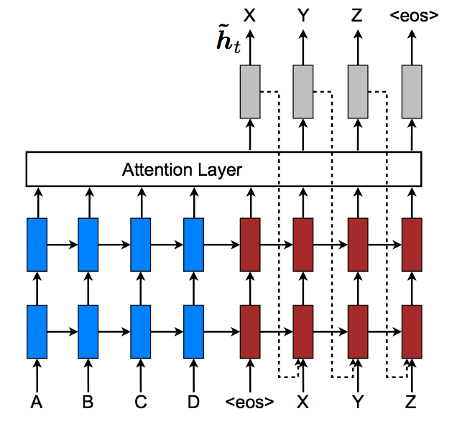
Attention

Slide 8
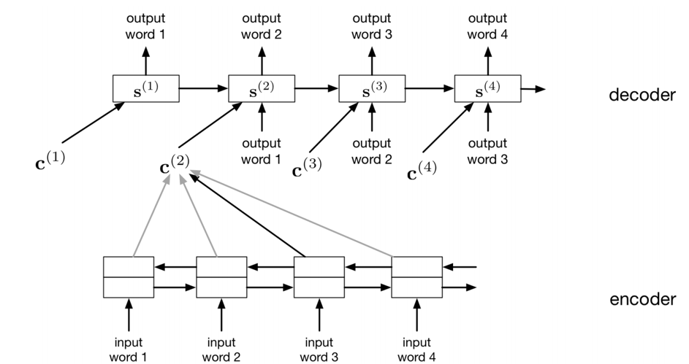
Attention Layer
The decoder network is an RNN. Like the encoder/decoder translation model, it makes predictions one word at a time, and the predictions are fed back in as inputs.
In the attention layer, a context vector is used as the input with the other information.

Slide 9
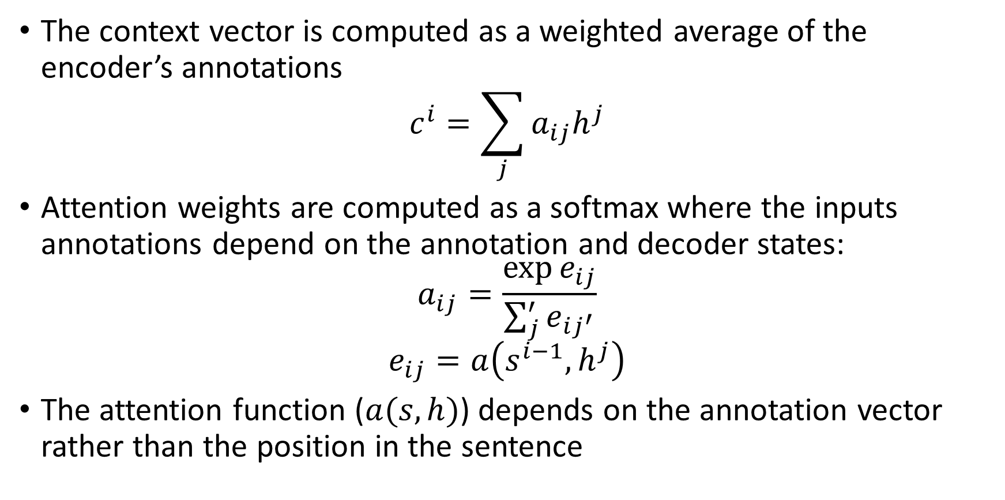
Attention
The context vector is computed as a weighted average of the encoder’s annotations
$$c^{i}=\sum_{j}{a_{ij}h^{j}}$$
Attention weights are computed as a softmax where the inputs annotations depend on the annotation and decoder states:
$$a_{ij}=\frac{\exp{e_{ij}}}{\sum_{j}^{′}{e_{ij^{′}}}}$$
$$e_{ij}=a\left(s^{i−1}, h^{j}\right)$$
The attention function ($a(s,h)$) depends on the annotation vector rather than the position in the sentence

Slide 10
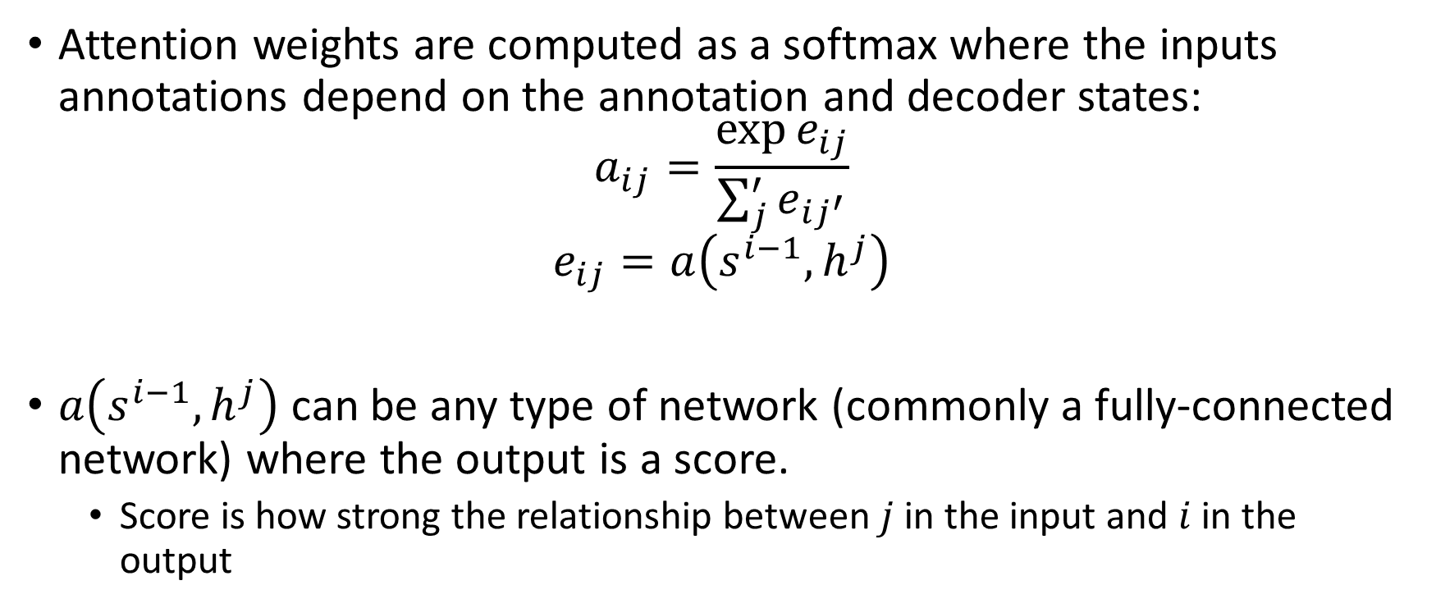
Attention layer calculation
Attention weights are computed as a softmax where the inputs annotations depend on the annotation and decoder states:
$$a_{ij}=\frac{\exp{e_{ij}}}{\sum_{j}^{′}{e_{ij^{′}}}}$$
$$e_{ij}=a\left(s^{i−1}, h^{j}\right)$$
$a\left(s^{i−1}, h^{j}\right)$ can be any type of network (commonly a fully-connected network) where the output is a score.
Score is how strong the relationship between $j$ in the input and $i$ in the output

Slide 11
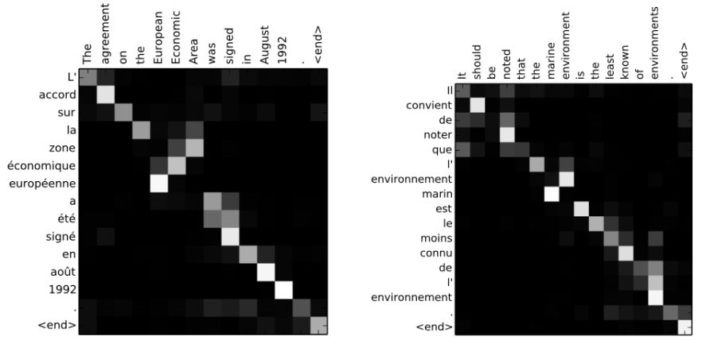
Attention in practice
In French to English translation, the relative position of adjectives and nouns can change. Attention can account for that in the model.

Slide 12
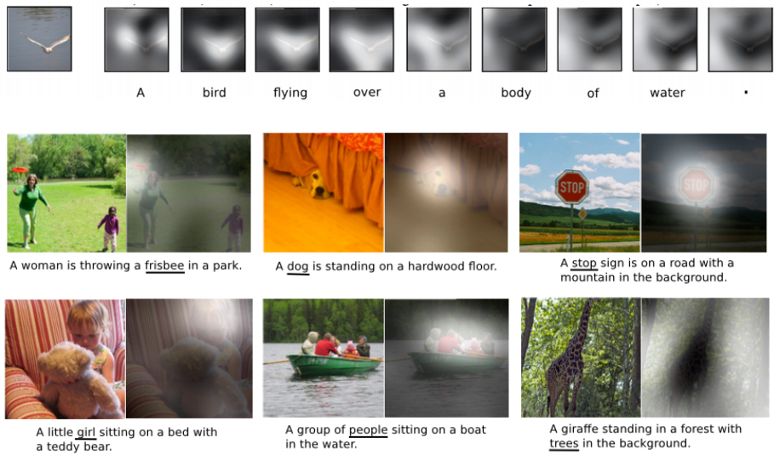
Attention in Other Contexts

Slide 13
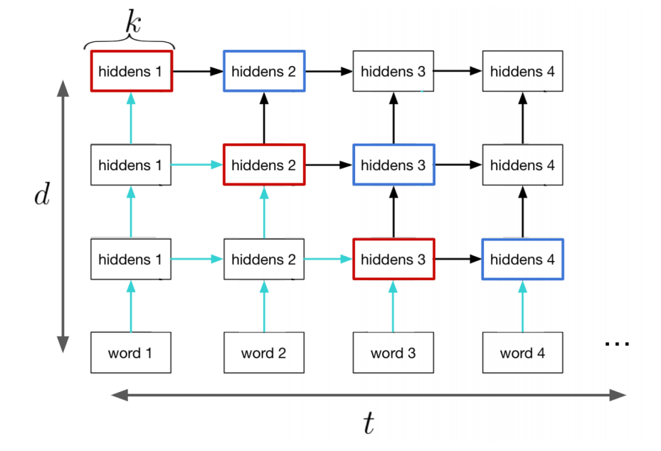
Challenge: RNNs cannot work well in parallel

Slide 14
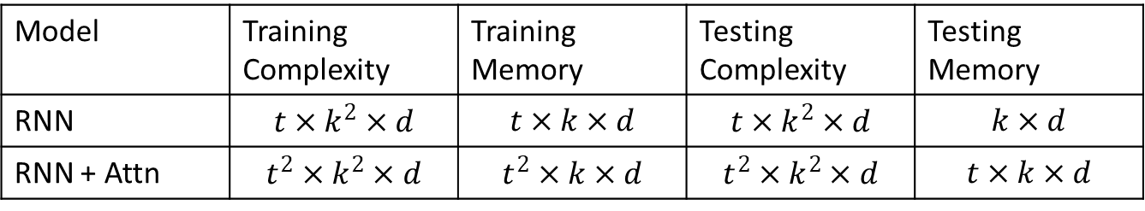
RNNs can be complex, and not support parallel operations
Inputs: t: length of sequence, d: # of layers, k: # of neurons
Attention requires additional information to recompute at every time step
Model | Training Complexity | Training Memory | Testing Complexity | Testing Memory
RNN | $$t×k^{2}×d$$ | $$t×k×d$$ | $$t×k^{2}×d$$ | $$k×d$$
RNN + Attn | $$t^{2}×k^{2}×d$$ | $$t^{2}×k×d$$ | $$t^{2}×k^{2}×d$$ | $$t×k×d$$

Slide 15
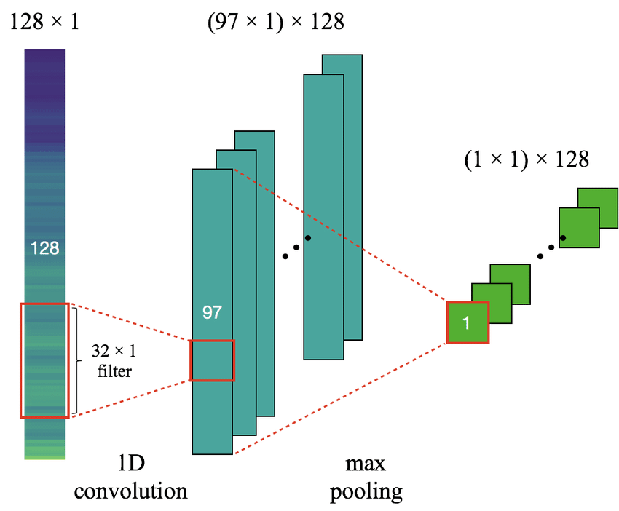
1D Convolution

Slide 16

Transformer Networks

Slide 17
Transformer Networks

Slide 18
Encoder Block – Self Attention

Slide 19
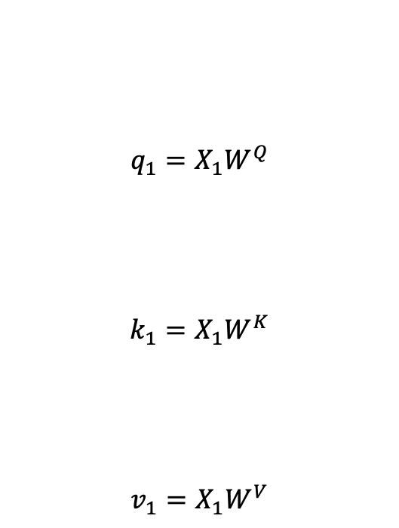
Encoder Block – Self Attention
$$q_{1}=X_{1}W^{Q}$$
$$k_{1}=X_{1}W^{K}$$
$$v_{1}=X_{1}W^{V}$$

Slide 20
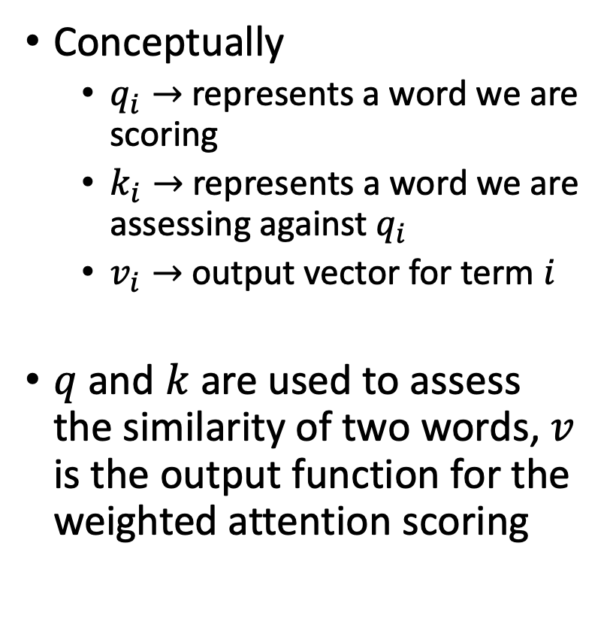
Encoder Block – Self Attention
Conceptually
$q_{i}→$ represents a word we are scoring
$k_{i}→$ represents a word we are assessing against $q_{i}$
$v_{i}→$ output vector for term $i$
$q$ and $k$ are used to assess the similarity of two words, $v$ is the output function for the weighted attention scoring

Slide 22
Transformer Networks

Slide 23
Transformer Networks

Slide 24
Transformer Results

Slide 25
BERT (similarly OpenAI GPT)
BERT - Bidirectional Encoder Representations from Transformers
Trained as a deeply bidirectional, unsupervised text representation
Trained by reading Wikipedia

Slide 26
BERT Training
Training process – sentences are entered in pairs into BERT
50% of the time the first sentence proceeds the second sentence, 50% of the time it does not
Goal is to predict if the two sentences are related

Slide 27
BERT Training
The entire input sequence goes through the Transformer model.
The output of the [CLS] token is transformed into a 2×1 shaped vector, using a simple classification layer (learned matrices of weights and biases).
Calculating the probability of IsNextSequence with softmax.

Slide 28
Using BERT today
https://github.com/google-research/bert
Classification tasks such as sentiment analysis are done similarly to Next Sentence classification, by adding a classification layer on top of the Transformer output for the [CLS] token.
In Question Answering tasks (e.g. SQuAD v1.1), the software receives a question regarding a text sequence and is required to mark the answer in the sequence. Using BERT, a Q&A model can be trained by learning two extra vectors that mark the beginning and the end of the answer.
In Named Entity Recognition (NER), the software receives a text sequence and is required to mark the various types of entities (Person, Organization, Date, etc) that appear in the text. Using BERT, a NER model can be trained by feeding the output vector of each token into a classification layer that predicts the NER label.

Slide 29
Other BERT Takeaways
Model size matters, even at huge scale. BERT_large, with 345 million parameters, is the largest model of its kind. It is demonstrably superior on small-scale tasks to BERT_base, which uses the same architecture with “only” 110 million parameters.
With enough training data, more training steps == higher accuracy. For instance, on the MNLI task, the BERT_base accuracy improves by 1.0% when trained on 1M steps (128,000 words batch size) compared to 500K steps with the same batch size.

